Slide 1
Local Jurisdiction Assistance Grant Program (“LJAGP”) Grant Application
Overview and Guidelines
Mendocino County

Slide 2
LJAGP Program Overview
Mendocino County was one of 21 local jurisdictions awarded funds from Department of Cannabis Control (DCC) for the LJAGP. This one-time funding is to assist local jurisdictions with the greatest need to transition provisional licenses to annual licenses. In January 2022, the County was awarded over $17.5 million in assistance, a portion of which was set aside by County staff to offer direct grants and fee relief to qualified provisional license holders located within the unincorporated areas of Mendocino County.
On January 11, 2024, the County received notification that the LJAGP Program Manual was approved by the DCC.
The manual will ultimately guide distribution of $4.8 million dollars to local operators to assist with the transition to annual licensure

Slide 3
LJAGP Program Guidelines (Overview)
Allowable uses are intended to encourage local jurisdictions to administer grant funds in ways that allow the DCC to transition provisional licenses to annual licenses more expeditiously without sacrificing California’s environmental commitments.
Services to be provided by the LJAGP Direct Grant and CEQA Relief Program may include fee relief and direct grants
The LJAGP direct grant program is intended to provide support to applicants and license holders that have a valid state provisional license in order to achieve state annual licensures.
Eligible provisional license holders may be awarded up to $25,000 reimbursement award which may be used for fee relief related to CEQA compliance and review, direct grants, or both.
Fee relief may be applied for and awarded as a part of the total grant budget and will be paid directly to the local permitting agency after submission of the appropriate fee relief forms.
Direct grants may be issued as a part of the total grant budget after the approval of a complete application submitted to the MCD.

Slide 4
Program Guidelines (Overview Continued)
LJAGP direct grant funds may be used for the following reimbursement for allowable expenses dated back to 1/1/22
The LJAGP Direct Grant Application period will open on March 1, 2024, at 12:01 am
Applications will be available on the MCD website
The Grant Application will remain open until the Department reaches 400 submissions
The application window may reopen if all grant funds have not been awarded after review of the original 400 applications

Slide 5
LJAGP Program Guidelines (Equity)
The grant calls for the prioritization of locally designated Equity operators with State Provisional licenses. To this end the County will allocate 25% of Direct Grant funding ($1.2M) exclusively to verified local or State licensed Equity Operators. The remaining 75% of Direct Grant funding ($3.6M), will be available for both equity and non-equity applicants and will be processed and distributed in the order they are received.
As a part of the direct grant application, equity applicants will be required to submit a copy of their equity eligibility certificate.
If an applicant would like to apply to be equity certified, this can be done during the LJAGP application process.
The Department will review equity applications and provide applicants equity certifications if applicable.

Slide 6
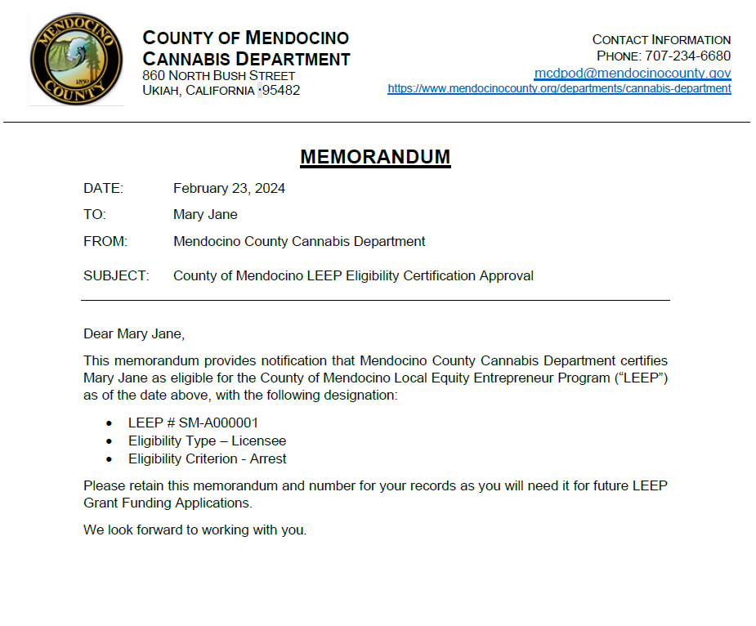
LJAGP Program Guidelines (Equity Certificate Example)

Slide 7
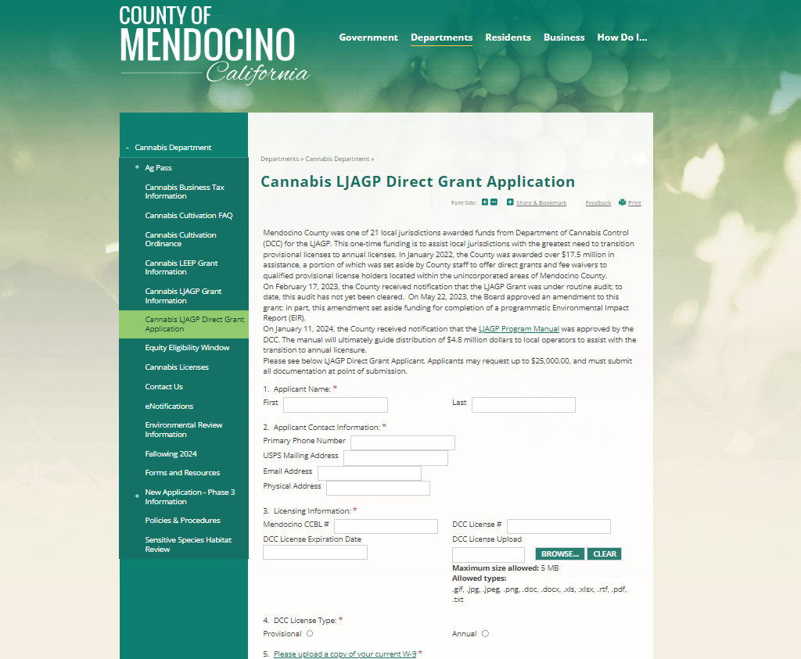
LJAGP Application Review

Slide 8
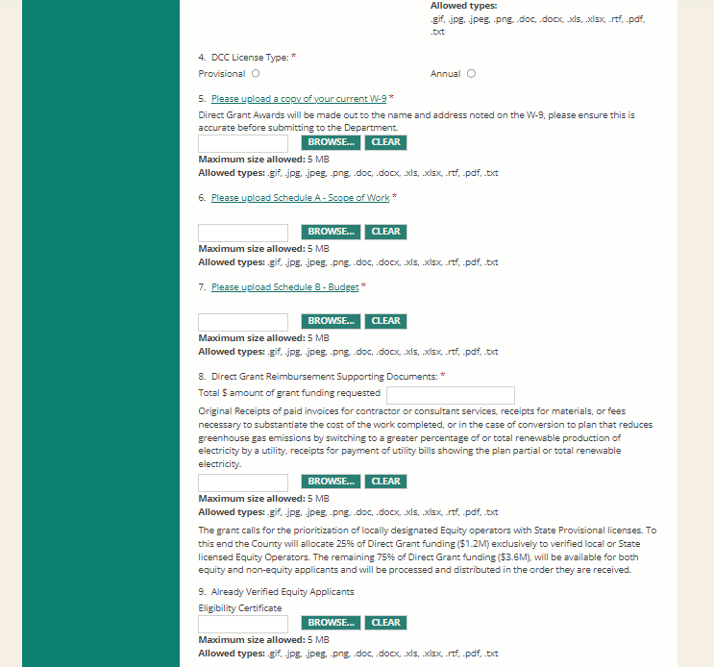
LJAGP Application Review
Notes:
Please note that all documents are hyperlinked

Slide 9
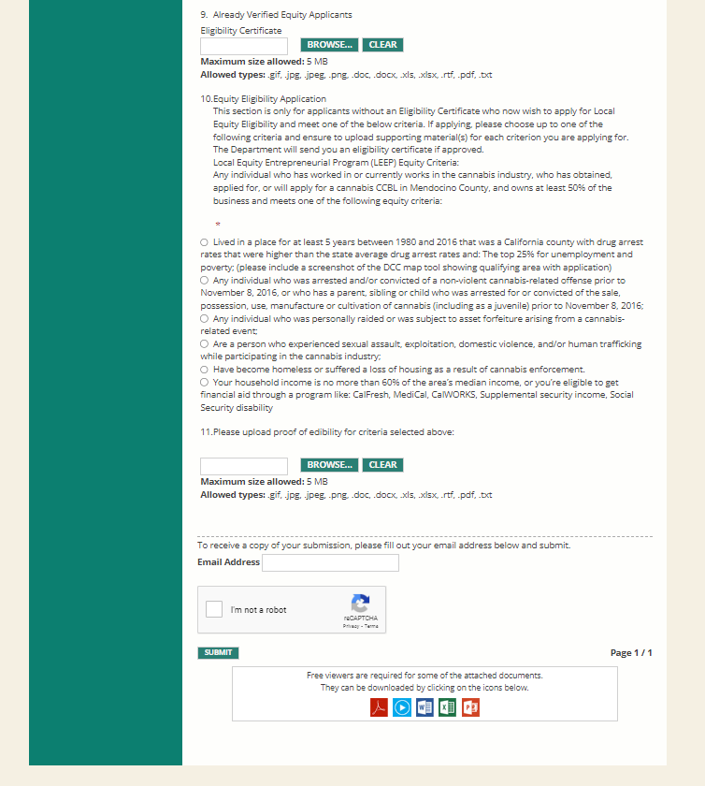
LJAGP Application Review

Slide 10
LJAGP Application Materials
A copy of DCC Provisional or Annual License
W-9
Direct Grant Awards will be made out to the name and address noted on the W-9, please ensure this is accurate before submitting to the Department.
If W-9 is in the name of a business entity, please ensure business entity has a valid bank account so the check can be cashed.
A blank fillable form of the W-9 can be found here.
Schedule A - Scope of Project
A narrative of all individual items in the Schedule B. Please describe what will be done with the line item, identify the amount, and provide the supporting Schedule B budget line item.
A blank fillable form of the Schedule A can be found here.
Schedule B - Budget
Expenses listed by line item.
A blank fillable form of the Schedule B can be found here.
All applicable receipts for reimbursement request, paid by applicant.
Other documents may include a copy of the applicants Local Eligibility Entrepreneurial Program ("LEEP") certificate or supporting LEEP eligibility criteria if the application is planning on applying for eligibility verification during the LJAGP grant application process. For more information regarding LEEP Eligibility please find more information on our Cannabis LEEP Grant Information page.

Slide 11
Application Materials
Document types accepted:
JPG
PDF
Mac Formats (Pages)
Microsoft Word
Microsoft Excel
Attachments
LJAGP Program Manual
Schedule A - Scope of Project - Blank Fillable
Schedule B - Budget - Blank Fillable
W-9 Blank Form

Slide 12
Application Materials
Document types accepted:
JPG
PDF
Mac Formats (Pages)
Microsoft Word
Microsoft Excel
Attachments
LJAGP Program Manual
Schedule A - Scope of Project – Filled out example
Schedule B - Budget – Filled out example
W-9 Form – Filled out example

Slide 13
Eligible Expenses & Examples Improving Air Quality and Reducing Greenhouse Gas Emissions
Direct Grant funds may be used for reimbursement of costs expended for the purpose of improving air quality and reducing greenhouse gas emissions (“GHG”) by eliminating or reducing the commercial cannabis business’ use of combustion engines. Projects eligible for reimbursements related to improving air quality and reducing GHG include:
a. Generators used to power, in whole or part, commercial cannabis business activities,
Generators would be used to reduce GHG or improve air quality for a backup generator.
Allowable Expense: Big diesel generator as backup now getting eco throttle inverter type generator that has a lower GHG emission rating or air quality rating
Not Allowable Expense: Adding in a new generator for a backup where one did not previously exist.

Slide 14
Eligible Expenses & Examples Improving Air Quality and Reducing Greenhouse Gas Emissions
Direct Grant funds may be used for reimbursement of costs expended for the purpose of improving air quality and reducing greenhouse gas emissions (“GHG”) by eliminating or reducing the commercial cannabis business’ use of combustion engines. Projects eligible for reimbursements related to improving air quality and reducing GHG include:
b. Water pumps used for the purposes of commercial cannabis irrigation and the business’ related potable water needs, including multi-use water systems
Example: Switching from a combustible engine to solar powered

Slide 15
Eligible Expenses & Examples Improving Air Quality and Reducing Greenhouse Gas Emissions
c. Other improvements and modifications of operations resulting in reduced County of Mendocino Cannabis Department (MCD) 3 greenhouse gas emissions including, but not limited to modification of lighting type or converting from nonrenewable or minimally renewable electricity plan to a plan with a greater amount of renewable electricity provided or lower greenhouse gas emissions
Costs related to other improvements or modifications of operations that result in reduced GHG. Example: Switching from a combustible engine to solar powered
Allowable Expense Examples:
Lighting type change, conversion to renewable energy (i.e., solar system install if it removes the need or reduces generator power either to comply with local ordinance to eliminate as primary source and/or to reduce GHG emissions and or air quality.
Costs associated with adding initial or additional solar panels to reduce primary or backup use of generator
Costs associated with structures or reroofing to support solar mounts, if not ground mounted
Costs associated with changing from a utility company plan that does not use renewable energy as the source of grid to a plan that does use renewables, or costs associated with changing from a plan that has some renewables to a plan that is exclusively using only renewables (reimbursement of utility bills at higher cost due to more or all renewable as source)
Not Allowable Expense: Adding in a new generator for a backup where one did not previously exist.

Slide 16
Eligible Expenses & Examples Improving Air Quality and Reducing Greenhouse Gas Emissions
d. Reimbursable costs include but are not limited to: consultants required for planning and permitting, equipment, installation costs, labor, and any additional items as approved by MCD related to improving air quality and reducing greenhouse gas emissions.
Consultants to help with any of the above, the equipment cost, the install cost, labor and permit fees.
Allowable Expenses Examples:
Paid a building permit consultant to help with solar building permit process
Paid an equipment operator to trench for electric lines from solar to electricity main
Actual cost of solar panels and/or batteries, labor paid to others for installation
Not Allowable Expense Examples:
Self-Dealing i.e., paying yourself to do work
Paying others for a project or paying for equipment that does not actually improve air quality or reduce GHG emissions.

Slide 17
Eligible Expenses & Examples Remediation
Direct Grant funds may be used for reimbursement of remediation and environmental correction related expenses including, but not limited to, the following circumstances:
a. Remediation of a commercial cannabis cultivation site located within a streamside management area, a wetland, and/or floodplain
Allowable Expenses Example: the cost to seed, straw and/or revegetate
b. Remediation of a commercial cannabis cultivation site that is determined to have potential impacts on sensitive species as identified during the Sensitive Species Habitat Review
Allowable Expenses Example: costs associated with remediation from SSHR review to address impacts to sensitive species i.e., vegetation planting, blackout windows

Slide 18
Eligible Expenses & Examples Remediation
c. Remediation of a commercial cannabis cultivation site as compelled by a state agency or as recommended in a biological or any other professional report submitted in the Sensitive Species and Habitat Review (SSHR) or CEQA processes.
Allowable Expenses Examples: Bio Report costs or report Recommendation costs related to SSHR or CEQA process
d. Reimbursable costs include but are not limited to: consultants required for planning and permitting, equipment, installation costs, labor, and any additional items as approved by MCD for remediation.
Allowable Expenses Examples: Costs associated with accomplishing recommendations from a Bio Report, SSHR, or CEQA process
e. Remediation is not permissible if it is already being funded by other means, including any other grant funding.

Slide 19
Eligible Expenses & Examples Premise Modification
Direct grant funds may be used for reimbursement of costs related to partial or complete cultivation premise modification on the same parcel, if retiring and premise modification was required to comply with an agency requirement, including but not limited to:
a. Vegetation modification associated partial site closure
Allowable Expenses Examples: Costs associated with this process, including consultant advice, contracted labor, equipment and supplies
Not Allowable Expenses Examples: Self-Dealing i.e., paying yourself to do work
b. SWRCB or CDFW related site premise modification
Allowable Expenses Examples: The setback to watercourse need to move location of garden or building, cost associated with doing this.
Not Allowable Expenses Examples: Self-Dealing i.e., paying yourself to do work

Slide 20
Eligible Expenses & Examples Premise Modification
Direct grant funds may be used for reimbursement of costs related to partial or complete cultivation premise modification on the same parcel, if retiring and premise modification was required to comply with an agency requirement, including but not limited to:
c. Any other partial or complete closure and premise modification of the same parcel as needed for any reason.
Allowable Expenses Examples: Costs associated partial or complete closure related costs as needed for any reason, consultant costs, contractors, costs to maneuver the above, equipment, installation, contracted labor
Not Allowable Expenses Examples: Self-Dealing i.e., paying yourself to do work

Slide 21
Eligible Expenses & Examples Hydrology and Water Quality
Direct Grant funds may be used for reimbursement of costs related to mitigation measures related to water conservation and water quality protection measures. Measures may include, but are not limited to the following:
a. California Department of Fish and Wildlife (CDFW) Lake or Streambed Alteration Agreement (LSAA) projects and related expenses including but not limited to:
Allowable Expenses Examples: LSAA permit fees such as notification major and minor amendment, and extension related to transitioning from provisional licensees to annual licensure, Hiring consultants and other professionals to provide technical support for completing notification and/or implementation of a LSAA required for local permitting and State annual licensure, and MCD, the purchase and installation of water meters as necessary to ensure compliance with surface water diversion and reporting requirements.

Slide 22
Eligible Expenses & Examples Hydrology and Water Quality
b. Projects and permits required by the State Water Resource Control Board (SWRCB), and the Division of Water Rights, including enforcement of the Cannabis General Order, and/or the Clean Water Act. Such projects and expenses may include but are not limited to:
Allowable Expenses Examples:
Hiring consultants and other professionals to provide technical support for the purposes of filing any required permits including but not limited to section 401 permits, Small Irrigation Use Registrations, and the payment of fees associated with such permits
Hiring consultants and other professionals to provide technical support for the development and/or implementation of Water Resource Protection or Site Management plans, and any other special or annual reporting to any division of the Water Board, the payment of fees associated with annual water reporting and monitoring programs related to transition from provisional to annual licensure, and the purchase and installation of water meters is necessary to ensure compliance with annual monitoring requirements.
Water meter purchase or installation costs

Slide 23
Eligible Expenses & Examples Hydrology and Water Quality
c. Projects that increase water conservation, and/or reduce reliance on surface water and groundwater resources. Such projects and expenses may include but are not limited to:
Allowable Expenses Examples:
Water availability studies and hydrological connectivity studies required by local and/or state agencies
Water availability analysis consultant costs, hydrologic connectivity analysis consultant costs
Planning and design costs
The installation of water storage and distribution systems including but not limited to ponds and water tanks, and rainwater catchment and distribution systems.
Cost of equipment (i.e. water tanks), supplies for the project, contracted labor for installation, permitting costs

Slide 24
Eligible Expenses & Examples CEQA and SSHR
Direct grant funds may be used for the reimbursement of expenditures by State provisional licensees in order to transition to a State annual license related to CEQA document preparation and any costs related to demonstrating a less than significant impact to sensitive species and habitat during the SSHR process, but are not limited to:
a. Direct grant funds may be used for the reimbursement of expenditures by State provisional licensees in order to transition to a State annual license related to CEQA document preparation and any costs related to demonstrating a less than significant impact to sensitive species and habitat during the SSHR process, but are not limited to: Allowable Expenses Examples:
Consultant fees for technical support for CEQA documentation preparation or SSHR responses, including tree removal issues and affidavits

Slide 25
Eligible Expenses & Examples CEQA and SSHR
Direct grant funds may be used for the reimbursement of expenditures by State provisional licensees in order to transition to a State annual license related to CEQA document preparation and any costs related to demonstrating a less than significant impact to sensitive species and habitat during the SSHR process, but are not limited to:
b. Hiring consultants and other professionals to prepare or submit associated studies used as a basis for demonstrating the project has a less than significant impact to sensitive species and habitat and which may be utilized in developing the project description or CEQA review, such as archeologic, biologic, hydrologic, forestry, invasive species management plans, engineering plans, geotechnical reports, soil studies, etc.
Allowable Expenses Examples:
Consultant fees to help with planning/permitting, equipment, install or labor (not self-dealing)

Slide 26
Eligible Expenses & Examples Other
6. Cost of Preparing Grant Application. Direct grant funds may be used for the reimbursement of costs related to the preparation of the LJAG application up to ten percent (10%) of the requested direct grant award amount.
7. Professional Compliance Assistance. Hiring consultants to support cultivators’ ability to maintain compliance with every local and state agency for which compliance must be maintained to achieve and maintain local licensing or necessary for state annual licensure.

Slide 27
Prohibited and Allowable Uses
Notwithstanding the previous slides, direct grant awards can only be used for those allowable uses identified in the Department of Cannabis Control’s Local Jurisdiction Assistance Grant Program: Guidelines and Application Instructions dated October 2021 (the “Guidelines”).
MCD will not award any direct grant funds for reimbursement of any prohibited uses identified in the Guidelines.

Slide 28
LJAGP Example Scenario
Mary Jane has paid for and has receipts for all kinds of costs since 1/1/22.
What receipts are considered reimbursable?
Allowable Expenses:
Paid consultant, contractor or attorney for work on planning and preparing Appendix G materials and any other CEQA documentation such as a Use Permit or preparation of studies.
Receipt for Water Board annual report, Water Board Annual fee, and any other required water fee, even if not annual such as SIUR application.
Paid solar contractor to design and obtain building permits for solar systems to reduce GHG emissions or air quality.
Paid equipment operator to level area for installation of pond or water tanks and for permits needed, if any.
Paid consultant or attorney for Vegetation Modification response. Analysis and prep for Tree Removal Affidavit, including arborist reports.

Slide 29
LJAGP Example Scenario
Mary Jane has paid for and has receipts for all kinds of costs since 1/1/22.
What receipts are considered reimbursable?
Not Allowable Expenses:
Items already paid from a different grant or fee waiver
No self-dealing or payment for own labor
Expenses paid before 1/1/22
Future work-Reimbursement period is from 1/1/22-2/29/24
No marketing or business expenses
Receipts for supplies for improvements unless the supply is specifically listed in one of the allowable expense categories.
Funds that are more than the $25k total

Slide 30
FAQ
Q: Can I apply and submit the required documentation at a later point?
A: No. All supporting documents must accompany the application.
Q: How will the Department process/prioritize applications?
A: The Department will manually close the application window when we receive
+/- 400 applications. After we receive the applications, we will establish equity applicants which will receive priority funding for 25% of funds. Then the Department will continue processing applications by order of receipt.
Q: How do I know if the window is closing soon?
A: The Department plans on launching the application at 12:01 am on March 1, 2024. The Department will manually close the application when we receive +/- 400 applications.
Q: How will I know where I am in the pool of 400 application submissions?
A: Currently, there is not a way for applicants to know what number their application was received in. The Department will reach out to individual applicants once review of their application begins.

Slide 31
FAQ
Q: Are equity applications treated differently?
A: Yes. Equity applicants have priority to 25% of total funding. The grant calls for the prioritization of locally designated Equity operators with State Provisional licenses. To this end the County will allocate 25% of Direct Grant funding ($1.2M) exclusively to verified local or State licensed Equity Operators.
Q: How do I establish equity funding?
A: Equity funding will be available for LEEP verified equity applicants who have a LEEP eligibility letter. For applicants that are not yet verified, but would like to apply, they can apply for Equity verification during the LJAGP grant application.
Q: How long after the application process will I receive award notification?
A: The Department will be processing applications and will reach out to individual applicants once review of their application is happening. At this time, there is not a set deadline to have all applications processed, however, the Department would like to have funds distributed prior to September 2024.

