Slide 1
Why Focus on Gender?
??????
Gender impacts ALL humans
Notes:
Teaching Point (TP): Framing this work
Some Ideas about HOW:
Meet people where they are
Intersectionality
Providing the support you need to integrate with your practices
Some Ideas about WHY:
Connections to overall diversity and inclusion efforts
Transgender and gender-expansive youth face great difficulties
Creating a gender inclusive school creates a better learning environment
Commitments as a school to social justice
Gender impacts every child

Slide 2
Understandings of Gender Are Changing
Fusion poll conducted in 2015 shows that the majority of Millennials (age 18-34) see gender as a spectrum, rather than a binary.
Notes:
TP: Ideas about gender are evolving, and young people are leading the way
This poll of individuals ages 18- 34 demonstrates that youth see and are comfortable with gender’s complexity
The fact that less than 50% of those surveyed agreed that gender is binary marks a dramatic shift in how gender is being viewed. This trend will only continue in one direction. And there is data showing this too!

Slide 3
And Fairly Rapidly
J. Walter Thompson Innovation Group recently released their research on how 13-20 year olds see gender…
56% knew someone who went by gender neutral pronouns such as "they," "them," or "ze,"
Over 1/3 strongly agreed that gender does not define a person as much as it used to
Only 44% said they always bought clothes designed for their own gender
70% support all-gender bathrooms
74 % are more accepting of
non-traditional gender
identities than they
were one year ago
Notes:
TP: Ideas about gender are evolving, and young people are leading the way
In fact, already Generation Z is building on these more complex ideas about gender…
(TRANSITION) and greater numbers are also more accepting of individuals whose gender identity is non-binary. Quite simply, youth are marching quite quickly toward very different landscape of gender than generations previously understood. And adults need to either get with it or get out of the way!

Slide 4
Dimensions
of Gender
Notes:
TP: A model that includes everyone
This is just a model, and only one model. Effective models are useful for establishing a baseline of language and conceptual understanding. Rather than arguing about “who has the right definitions” we instead like to talk about what are the words we are using and how are we using them “right now.” Especially given how much the language of gender is shifting, as well as because so much of the confusion comes from assumptions about the words we use, it is crucial we slow down enough to make sure we are on the same page with the words we are using to discuss the subject!

Slide 5
Three Essential Ideas
A person’s experience of gender is informed by three dimensions:
Body
Identity
Expression
Each dimension is a spectrum
Gender and sexual orientation are different
=
Gender
Notes:
TP: Gender is more complex than most realize
These three basic ideas are critical to understanding the authentic gender experiences of others. Internalizing them can be transformative, creating a completely different view of what gender is, how it affects each of us, and why we must begin to think about it in more nuanced ways.
(TRANSITION) Gender is informed by multiple aspects, or dimensions
(TRANSITION) Each of these dimensions is best understood as a spectrum (as compared to a binary)
(TRANSITION) Gender and sexual orientation are not the same thing

Slide 6
Dimensions of Gender
Body: includes our sex (currently defined as male, female, or intersex and based on primary sex characteristics), as well as our experience of our own body, how society genders our body and interacts with us based on our body
Identity: the name we use for our gender based on who we internally know ourselves to be
Expression: how we present our gender in the world and how society, culture, community, and family perceive, interact with, and try to shape our gender
Notes:
TP: The Body
When we talk about the body dimension, we are including and individuals physical sex, but also other aspects of the person’s body as well (such as body shape and size, body hair, musculature, chromosomes and hormones. Sex is not the only part of our body related to gender,
Think about the various physical attributes that are associated with gender. In ways both positive and negative, we gender our bodies in lots of ways! For young people, this can be very challenging as they seek to mold their bodies into some pre-ordained notion of being a man or woman. Whether it is taking steroids to build muscle, developing an eating disorder to have a certain body type, or in some other ways, healthy or not, modifying one’s body is frequently another way (with nothing to do with our private parts) that a body is an aspect of one’s notions of gender.

Slide 7
Gender
Female
Intersex
Male
X
Binary
Notes:
TP: Gender Binary vs. Gender Spectrum – bodies
We look at genitalia, which are used to assign sex.
(TRANSITION). This is the foundation of the Gender Binary, the dominant model of gender in our society. In this model, “gender” equals “sex,” and there are only two sexes → thus only two genders. From there, we presume gender. For many people, this is where gender begins and ends. This is why the binary model predominates in our society. The assignment of their gender based on anatomy ends up being consistent with their experiences of gender as they grow up. They are born and sent out into a world that is designed around this genitalia-based and binary model. And for many people this suffices to capture much of their experience. It also happens to come with a great deal of (often unexplored/unrecognized) privilege. But it just doesn’t work for all of us!
But even the idea of “two sexes” is not accurate for all bodies; even at the anatomical level, the binary breaks down.
(TRANSITION) Bodies come in more than two types, and the biological dimension is in fact much more accurately depicted as a spectrum. While there are two primary forms of genitalia, these two are not the only possibilities. There are a number of naturally occurring variations that break the binary pattern. The term “intersex” is frequently associated with these naturally occurring variations.

Slide 8
Intersex
Describes a person who doesn’t fit the typical definitions of male or female
Variations in gonads, genitalia, or chromosomes
Naturally occurring, estimated to be ~2% of live births*
* Blackless, M., Charuvastra, A., et al. (2000). “How sexually dimorphic are we? Review and synthesis.” American Journal of Human Biology: The Official Journal of the Human Biology Council
Notes:
TP: What does intersex mean?
Intersex conditions have many forms: ambiguous genitalia, where a child has what appears to be neither a fully developed penis and testicles or a fully developed vulva.
There can be individuals who are born with what appear on the outside to be typically one kind of genital arrangement, only to learn that internally they have tissues or even fully formed organs (though not functional) of the “other.” For example a child can be born and assigned a female gender, but when they hit puberty and do not develop, examination can reveal an intersex condition. There are also various chromosomal arrangements that break the binary rule. Additionally, there are different syndromes that cause a body to change as the child grow—an apparently masculine child’s body will feminize as it gets older (Kleinfelters Syndrome),
Very many of these difference are invisible to the naked eye, meaning you can never tell whether someone is intersex, and in some cases individuals themselves may not be aware for many years.

Slide 9
Gender
Binary
Notes:
TP: The binary is simply too simplistic
The binary gender system is flawed, and yet because it is consistent with the experiences of many people, it is assumed to be universal when it is not! The dominant experience is not the only experience. This alone should be enough to demonstrate the limitations of a binary model of gender.

Slide 10
Dimensions of Gender
Body: includes our sex, as well as our experience of our own body, how society genders our body and interacts with us based on our body
Identity: our personal sense of gender, who we internally know ourselves to be
Expression: how we present our gender in the world and how society, culture, community, and family perceive, interact with, and try to shape our gender
Notes:
TP: Gender Identity
Identity is the second dimension of gender. It represents the deeply held sense of one’s self. It is a core aspect of who we are, and is universally recognized (by creditable professional associations of pediatric, psychological, psychiatric, legal, child welfare providers across the world) as an essential component of a person’s makeup.

Slide 11
Boy
Female
Male
Dimensions of Gender
4
Body
Girl
Notes:
TP: Identity is also a spectrum.
The gender binary assumes people can identify as either a boy or a girl, man or woman.
(TRANSITION) But like our bodies, identity is also a spectrum. Our gender identity is determined by each of us alone as individuals. Who we know ourselves to be, how we feel is something each of determines for ourselves. Again, while for many people this internal sense of self is consistent with the sex they were assigned, for others it is not.

Slide 12
Trans
Gender Queer
Genderless
Intergender
Transfeminine
Androgyne
Genderflux
Masculine of center
Two-Spirit
Cisgender
Agender
Bi-gender
Gender Queer
Demiboy
Gender Fluid
Femme
Non-binary
Butch
Neutrois
Pangender
Notes:
TP: Ideas and language about gender identity are evolving
(TRANSITION) And here we see the language of gender literally exploding. Young people are operating from a completely different set of terms and concepts about the diversity of gender identities that they and their peers are asserting. This evolving language of gender is at the heart of real sea change in our society when it comes to gender.

Slide 13
When Did You Know?
When did you realize what your own gender was?
How did you know?
Notes:
TP: Just what is gender identity?
These next slides are designed to help establish the concept of gender identity. Just what is it, at a gut level? Think about when you realized what your own gender was. How did you know? What messages did you receive about whether you were “right” when you shared it with others? How did those around you respond to your sense of your gender?

Slide 14
Gender Identity Is Established Early
By age four, most children have a stable sense of their gender identity.
--American Academy of Pediatrics (2015)
This is true for all kids, regardless of their gender identity.
Notes:
TP: Gender identity forms early
Here is what the American Academy of Pediatrics, the country’s leading and most respected professional organization for doctors who work with children and youth.
As you think about your answer to the question, “When did you know?” is this consistent with your reflection? What the AAP is telling us is that most children (though not all) have a very clear sense of their gender identity from a very young age.
(TRANSITION) This is true for all kids, regardless of gender identity.

Slide 15
It Might Be Years Before T/NB Youth Discuss It
Average Age of Self Realization
7.9
Average Age of Disclosure
15.5
Savage & Lagerstrom (2015)
Notes:
TP: Though they often recognize their identity quite early, many youth will not share this with others
Savage & Lagerstrom (2015) found that 80% of transgender adults knew their gender identity before the age of 10; 96% knew before the age of 18. While the average age of self-realization was 7.9, it was not until age 15.5 that transgender individuals reported knowing how to describe their feelings. Those years in between self-realization and outward expression was a time often marked by fear and shame, with little support from families or schools. Imagine the impact a gender inclusive educator can have on this gap of time.
Imagine if Devina did not have such a perceptive kindergarten teacher. How long would it have been for her?

Slide 16
Gender Identities: A Small Sampling
Notes:
TP: Various identity names

Slide 17
Binary Identities
The concept that a person’s gender is either boy/man, or girl/woman
Cisgender: gender identity aligns with their assigned sex at birth
Transgender: gender identity is different from their assigned sex at birth
Notes:
TP: Binary gender identities

Slide 18
Non-Binary Identities
The concept that a person’s gender is not solely boy/man, or girl/woman
Bi-gender: any two gender identities
Demi-gender: non-binary with partial connection to a gender
Gender fluid: identity that changes
Genderqueer: non-conforming in identity or expression; can be an identity or an umbrella term
Polygender: multiple gender identities
Transgender: gender identity does not match assigned sex; can be an identity or an umbrella term
Transgender: gender identity does not match assigned sex; can be an identity or an umbrella term
Notes:
TP: Binary gender identities

Slide 19
Agender
Not identifying with any gender; often used by individuals who do not feel connected to gender or who do not wish for to be ascribed the characteristics often connoted by a gender label
Notes:
TP: Agender is a third category
Individuals who do not identify with a particular internal sense of gender will sometimes use this term to capture their sense of self.

Slide 20
Dimensions of Gender
Body: includes our sex, as well as our experience of our own body, how society genders our body and interacts with us based on our body
Identity: our personal sense of gender, who we internally know ourselves to be
Expression: how we present our gender in the world and how society, culture, community, and family perceive, interact with, and try to shape our gender
Notes:
TP: Expression
Expression is about how we show our gender in the world and how others interpret that presentation. Gender is frequently described as a “social construct,” and gender norms related to expression are a major part of that construct. Often referred to as “gender” expression, it might be more accurately described as “gender-ed expression; there is nothing inherent to our gender in how we dress, or what we like to play with, or what interests us, or the jobs we do…

Slide 21
Boy
Girl
Boy
Dimensions of Gender
4
Identity
Body
4
Girl
Notes:
TP: Expression norms are frequently quite binary
Much of society operates from very binary notions of expression, believing there are ways to express oneself as a boy and another, separate set of ways for girls.
(TRANSITION) Kids are surrounded by binary notions of expression.

Slide 22
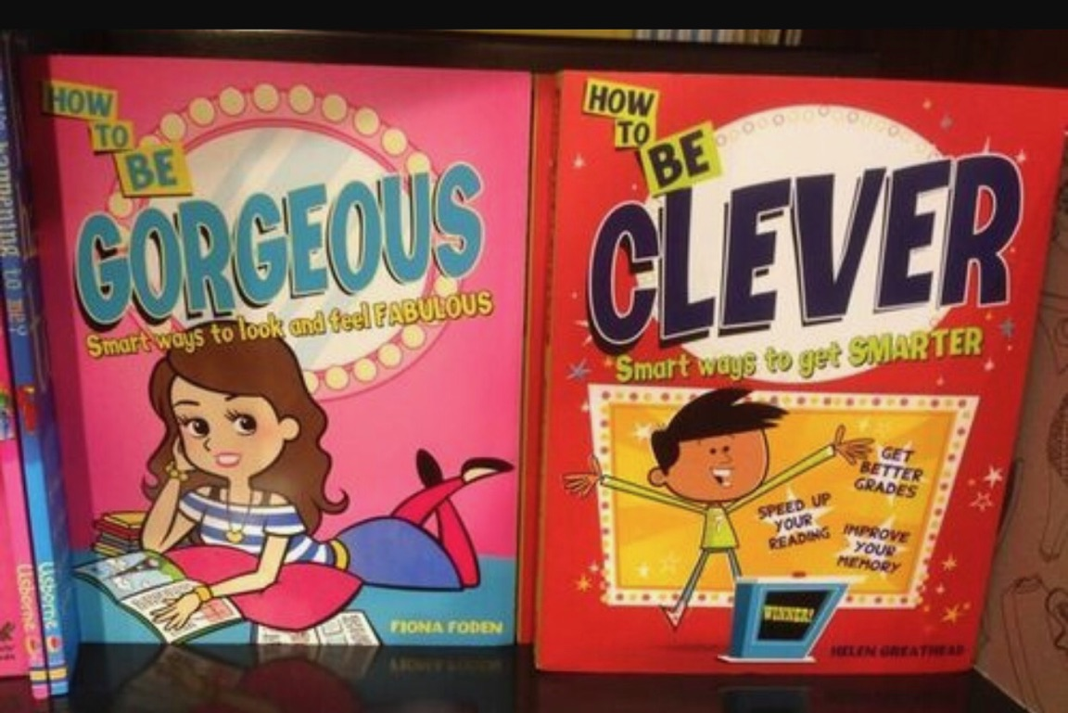
Notes:

TP: These messages are everywhere
What decade do you think these were written? The fifties or sixties? Seventies or eighties? Nineties? 2012!!

Slide 23
Boy
Girl
Boy
Dimensions of Gender
Body
Identity
Girl
Notes:

TP: Rather than a simple binary, Expression is also a spectrum
While binary ideas about expression may be everywhere, simple reflection reveals that they are inaccurate. Like the other dimensions, expression is also a spectrum with infinite possibilities

Slide 24
Throughout time and from one culture to another, gender norms constantly are changing
Notes:
TP: Expression norms are not constant or universal
Of course, the binary notions of expression are not universal nor fixed; we have many examples that show how it can and often is challenged and frequently changing.

Slide 25
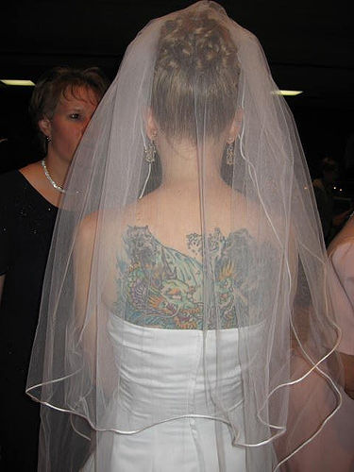
How about women or girls with tattoos?
Norms around gender expression change over time!
Notes:
TP: Two examples of shifting expression norms
Think about boys/men wearing earrings—how many of you knew boys/men wearing them when you were 10 years old? How about now? At 10, how many of you knew women (or girls) with tattoos? How about today?
Classic examples of how the norms of gender expression shift, and will continue to shift across time!
But for young people, there is a view that what is has always been, and always will be. Thus, they assume that the binary notions they are bombarded by will always exist. We must help them see that these things shift all the time, and will continue to do so.

Slide 26
Patterns
Patterns vs. Rules
Notes:
TP: Patterns vs. Rules
You’ll notice that the children often describe patterns that they see in the world around them, and some times those patterns are accurate– like most boys don’t wear dresses or even want to wear dresses.
(TRANSITION) But that doesn’t mean that the patterns are rules. Because some boys do like to wear dresses, some girls don’t like to wear dresses and lots of kids like to think for themselves! Our job as adults is to avoid making assumptions about individual kids based on the patterns we see around us. And to help young people understand these concepts as well. Gender Inclusive schools interrupt these ideas by making sure that any person not fitting the common pattern is not made to feel bad or mistreated.
It is ok to notice, and even operate from patterns. But when a child varies from the pattern, the issue rests with the person who made the assumption about that pattern. Prepare to be wrong, and instead of blaming the child, recognize the mistake you’ve made by coming to a conclusion that was not accurate! Re assess the data and come to a new conclusion. Maybe the pattern you are working from is often true, but not always.

Slide 27
Body
Expression
Identity
=
Gender
≠ Sexual Orientation: Refers to a person’s physical and emotional attraction to others
Notes:
TP: Gender and sexual orientation are not the same thing
In discussing these three dimensions of gender, you will notice that we have not talked about bring gay, or lesbian, or bisexual or pansexual or asexual or….
(TRANSITION) That is because these refer to a person’s sexual orientation, which is not the same thing as a person’s gender. Sexual orientation is about a person’s attractions to other people; sexual orientation is typically understood in terms of other individuals, while gender is understood in relation to our own sense of self.
(TRANSITION) It is critical to distinguish gender from orientation, particularly for younger kids because gender expression that is not consistent with their perceived gender is frequently equated with being gay. We assume we know a person’s sexuality simply be the way they express themselves. More importantly, adults frequently sexualize something that has nothing to do with sex, thus making a child’s authentic pursuit of self into some sort of sexual issue when it most certainly is not. This is particularly problematic when it comes to addressing the needs of transgender students in spaces such as restroom, locker rooms, and during overnights where there are shared sleeping accommodations.
Using an adult lens of sexuality to define the experience of a kid’s assertion of identity is inappropriate. This minimizes and confuses the young person’s exploration of self. Also,
with the lens of sex comes assumptions about how supporting a gender-expansive child has sexual overtones. A transgender girl in the restroom is viewed as a potentially sexual situation. It is not about sex; it’s about identity and dignity.
In either of these instances, we give short shrift to both the person’s authentic gender as well as the development of their sexual identity.

Slide 28
Gender Congruence
The degree to which the three dimensions of gender are in harmony with one another
Everyone seeks gender congruence, and we may experience periods in our lives in which are gender is more congruent and periods when it is less so.

Slide 29
Personal Gender
We are all more than our body, identity, and expression: we are also our race, ethnicity, class, faith community, sense of geographic place, family history, community’s gender roles and expectations, etc.
Our gender is personal because while we share some of these aspects of self with others, the way that all of these identities, influences, and characteristics come together is unique to each of us.

Slide 30
Each of us should determine for ourselves the name we use to identify our gender and what that name means.
Notes:
TP: Gender is personal
Creating a more inclusive environment for all of our kids is not about eliminating gender, or saying that gender does not matter. It is about creating spaces in which kids are able to define for themselves what gender means. It is our responsibility as adults to establish the conditions in which children are affirmed for who they are. This can feel intimidating; but in fact, it should be liberating. No longer do you need to define who another person is; as we’ve seen, given the exploding language of gender that can be a tall order indeed! Instead, it is up to others to tell us who they are. Our job is to create the space, not to FILL the space so they can do so.

Slide 31
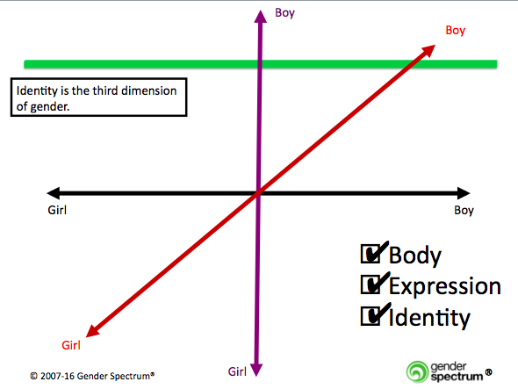
Discussion
What questions or comments do you have about these three dimensions of gender?
How do they relate to the work you do with students and families?
Notes:
TP: Debriefing
(~ 5-7 minutes) A good opportunity for people to check in; Encourage people to stand up and find a partner elsewhere in room; this will get them moving.

